Slide 1
Communication Skills
Rimma Quadros

Slide 2
7 C’s of Effective Communication
Completeness
Clarity
Courtesy
Conciseness
Consideration
Correctness
Concreteness

Slide 3

Completeness
I did not receive any response for the complaint I lodged:
I made a complaint to the Branch Manager on June 23, 2003 on the inordinate delay at the cash counter. Can I get a response?
I want a room booked in your hotel for three days in the first week of the month of July:
I will be arriving on July 3rd morning by Pandora Express. I want a single room accommodation for three days from 3rd morning. I want a room with attached toilet, running hot water facility and telephone (if available). Kindly do the booking in my name.

Slide 4
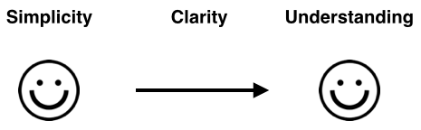
Clarity
Hi John,
I wanted to write you a quick note about Daniel, who's working in your department. He's a great asset, and I'd like to talk to you more about him when you have time.
Best,
Skip
What is this email about? Well, we're not sure. First, if there are multiple Daniels in John's department, John won't know who Skip is talking about.

Slide 5
Hi John,
I wanted to write you a quick note about Daniel Kedar, who's working in your department. In recent weeks, he's helped the IT department through several pressing deadlines on his own time.
We've got a tough upgrade project due to run over the next three months, and his knowledge and skills would prove invaluable. Could we please have his help with this work?
I'd appreciate speaking with you about this. When is it best to call you to discuss this further?
Best wishes,

Slide 6
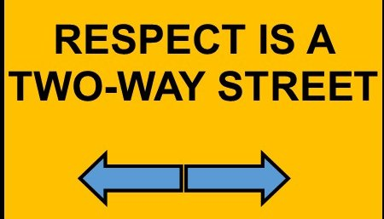
Courtesy
Courteous communication is friendly, open, and honest. There are no hidden insults or passive-aggressive tones. You keep your reader's viewpoint in mind, and you're empathetic to their needs

Slide 7

Conciseness
What you have to say in the fewest possible words without sacrificing the other C qualities. A concise message is complete without being wordy. For eg use ‘Now’ instead of ‘At this time’

Slide 8
Wordy: In due course
Concise: Soon
Wordy: please find attached the list you requested.
Concise: The list you requested is attached.
Wordy: She bought desks that are of the executive type.
Concise: She bought executive- type desks.

Slide 9
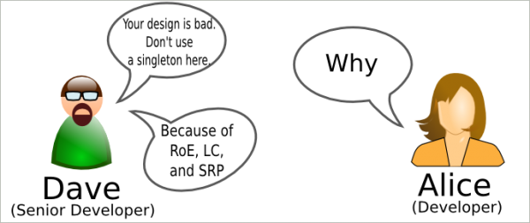
Consideration
To consider the receiver’s Interest/Intention. It is very important in effective communication while writing a message you should always keep in mind your target group
Three specific ways to indicate consideration Focus on “you” instead of “I” or “We” .Show audience benefit or interest of the receiver Emphasize positive, pleasant facts.

Slide 10
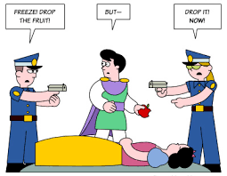
Correctness

Slide 11
Concreteness
Supported with specific facts and figures

